Slide 1
CSS
CSS key points
-David Dong

Slide 2
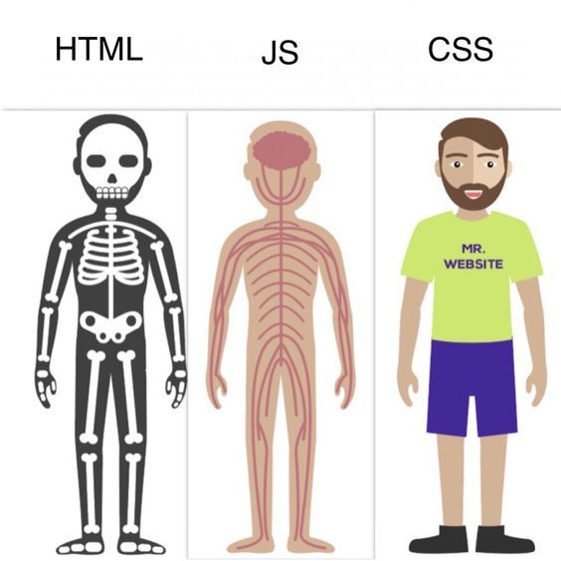

Slide 3
Import CSS (Cascade)
How to import CSS
Inline, attribute
style=“height: 20px, background-color: red”
create CSS file and import, external CSS
<link res=“stylesheet” href=“index.css”>
Internal CSS
<style></style>
Priority: inline > internal > external

Slide 4
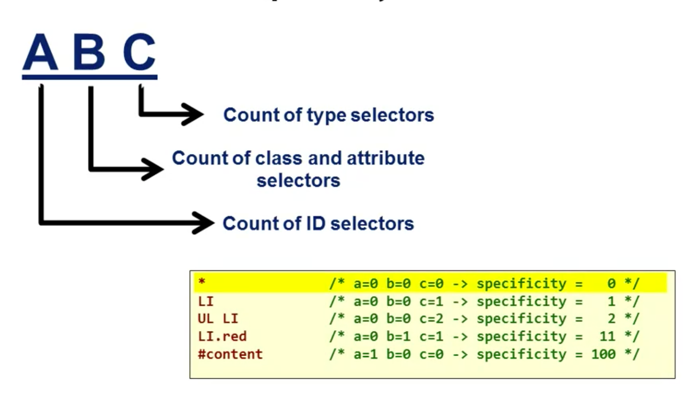
CSS selector (Specificity)

Slide 5
CSS selector
Type selectors (e.g., h1) and pseudo-elements (e.g., ::before).
Class selectors (e.g., .example), attributes selectors (e.g., [type="radio"], [id=“id”]) and pseudo-classes (e.g., :hover).
ID selectors (e.g., #example).
Universal selector (*), combinators (+, >, ~, ' ', ||) and negation pseudo-class (:not()) have no effect on specificity. (The selectors declared inside :not() do, however.)
Descendent selector: div div
Child selector: >
Priority: id > attribute

Slide 6
CSS selector
Regular expression: ?, ^
[class*="col"] [class^="col-"] [class$="-col"]

Slide 7
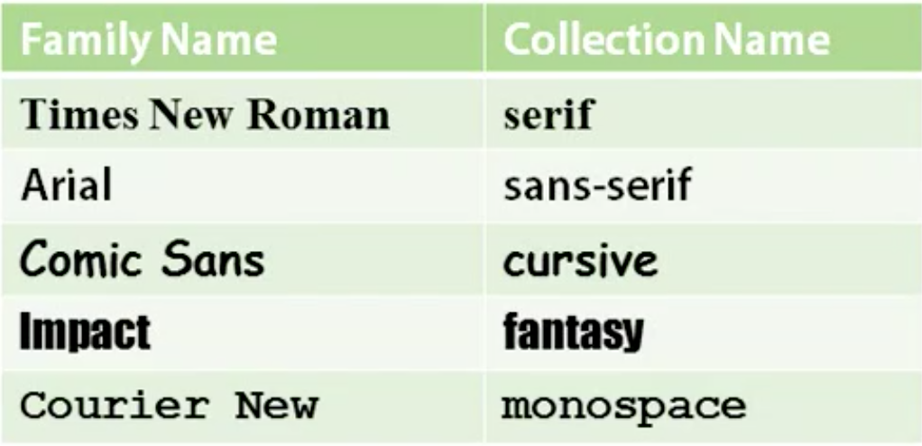
Font collections

Slide 8
Font size & style
PX: Pixels (px) are considered absolute units, although they are relative to the DPI and resolution of the viewing device. But on the device itself, the PX unit is fixed and does not change based on any other element. Using PX can be problematic for responsive sites, but they are useful for maintaining consistent sizing for some elements. If you have elements that should not be resized, then using PX is a good choice.
Relative Units
EM: Relative to the parent element
REM: Relative to the root element (HTML tag)
%: Relative to the parent element
VW: Relative to the viewport’s width
VH: Relative to the viewport’s height
Unlike PX, relative units like %, EM, and REM are better suited to responsive design and also help meet accessibility standards. Relative units scale better on different devices because they can scale up and down according to another element’s size.

Slide 9
Parameters
box-sizing: (default)content-box, border-box
position: fixed, absolute, relative, (default)static, sticky
fixed related to the screen.
absolute related to the first element tag which not position static.
relative related to current position.
sticky
Carousel

Slide 10
layout
display: flex
flex-direction: (default)row, column
flex-wrap:
flex-grow:
Flex box comes from CSS 3
Before CSS 3, we use float.
→ Bootstrap layout: grid system.
Use flex to create a layout as an example in the grid system.

Slide 11
layout
→ Bootstrap layout: grid system.
Use flex to create a layout as an example in the grid system.
make a responsive page.
width: calc(1 / 12 * 100%);
@media (max-width: ) and (min-width: ) {
}
Let’s work with assignment.

Slide 12
Assignment
BEM to name element class in the project
html structure.
CSS to markup the page.
Semantic templets,
form: we use even.preventDefault() block the default behaver of form.
Label: example: a label related to checkbox, you can select the checkbox by click the label.
The different button and input button.
Input button is a self close tag, you can only use value attribute for its.

Slide 13
How to build a webpage
Html layout first.
Try to use semantic html.
Html markup with CSS.

